Slide 1
DATA ANALYSIS IN THE CLOUD
TIME SERIES FORECASTING
Group 2:
Dhruv Singh Chandel: 222100671
Ankush Arora: 221202855
Balram Tiwari: 222100583
Ravi Singh: 222100546
Unmesh Mhatre : 222100576
Prof. Dr. Frank Hopfgartner
Mentor: Tania Sennikova
Summer term 2023
RESEARCH LAB

Slide 2
TABLE OF CONTENTS
Introduction
Research Overview
Research Methodology
Implementations
Collective Insights
Key Takeaways
Future Work
References
Q and A
Summer term 2023
RESEARCH LAB

Slide 3
INTRODUCTION
Each team member explored on a unique dataset and employed various forecasting algorithms.
The key aspects of our research involved benchmarking the performance of these algorithms on the diverse datasets, shedding light on their predictive capabilities.
Our aim is to share the valuable insights we've gained from this experience, showcasing the diverse applications and predictive power of these techniques in the field of time series analysis.
Summer term 2023
RESEARCH LAB

Slide 4
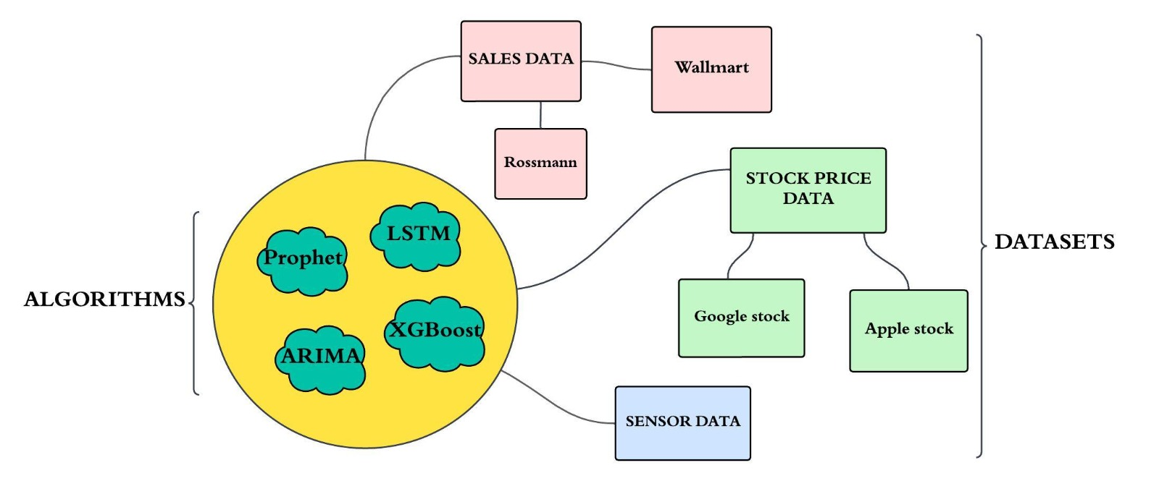
RESEARCH OVERVIEW
Summer term 2023
RESEARCH LAB

Slide 5
RESEARCH METHODOLOGY
Literature Review: In the initial weeks, we extensively studied research papers on time series forecasting. This phase equipped us with a deeper understanding of state-of-the-art techniques and trends in the field.
Dataset Selection: After a thorough review, we carefully selected our datasets—each dataset representing a unique domain, including stock prices, sales data, and sensor readings.
Summer term 2023
RESEARCH LAB

Slide 6
RESEARCH METHODOLOGY
Algorithm Selection: Building on the knowledge gained from the literature, we handpicked four diverse forecasting algorithms
Algorithm Optimization: Upon implementing these algorithms on our datasets, underwent further optimization, involving techniques such as windowing, feature extraction, and hyperparameter tuning.
This approach allowed us to extract maximum predictive power from each algorithm, ultimately yielding valuable insights into their performance."
Summer term 2023
RESEARCH LAB

Slide 7
IMPLEMENTATION
Summer term 2023
RESEARCH LAB

Slide 8
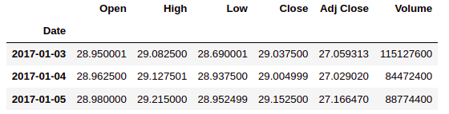
Time Series Forecasting : Apple Stock Data
DATASET
Data Source: I utilized historical Apple Inc. stock price data obtained from Yahoo Finance from January 1, 2017,to December 1, 2022.
Features: Our dataset encompasses a range of essential financial indicators:
Data Quality Check: Ensure the dataset is free from missing values (null values) or any anomalies.
Train-Test Data Split: The dataset was split into training(80%) and testing sets (20%)
Objective: Our primary objective revolves around forecasting the closing price of Apple stock by leveraging historical data and employing various machine learning techniques and algorithms.
Summer term 2023
RESEARCH LAB

Slide 9
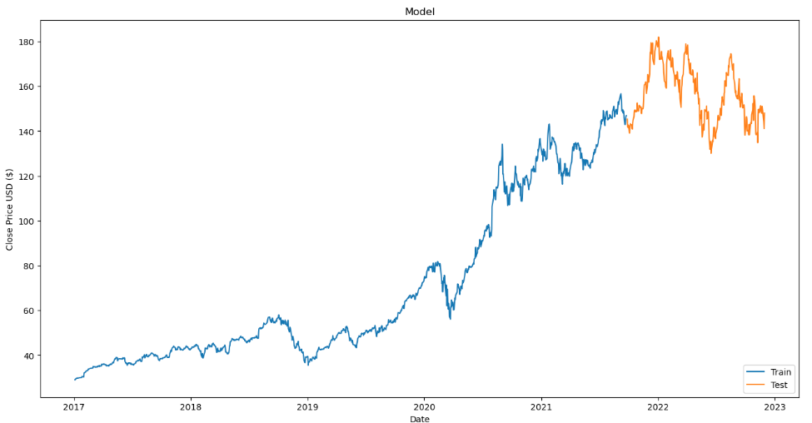
Time Series Forecasting : Apple Stock Data
DATASET
Summer term 2023
RESEARCH LAB

Slide 10
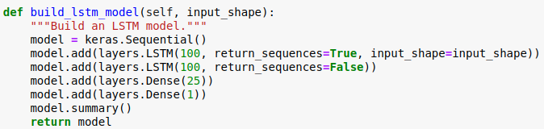
LSTM
Data Processing: I normalized our data to bring it within a uniform range. This process enhances model convergence and training stability.
Model Configuration: Our initial model is built using Keras with the following architecture:
Initial Model Feeding: When I passed my normalized data into the model, I obtained an RMSE value of 150.02.
Impact of Windowing on RMSE: To capture temporal patterns within our time series data, we introduced the "windowing" technique. This involves segmenting our data into overlapping windows of a fixed size.
Model Feeding: When I passed my normalized window frame data into the model, I obtained an RMSE value of 8.35.
Summer term 2023
RESEARCH LAB

Slide 11
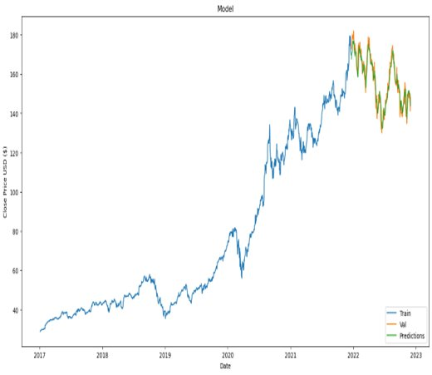
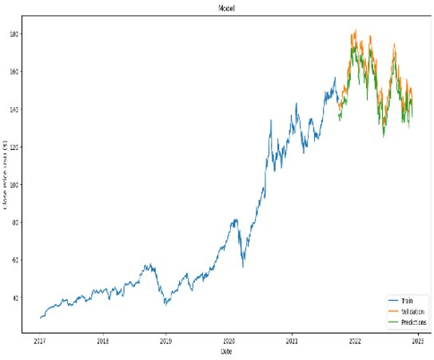
LSTM
Model with Windowing
Initial Model
Summer term 2023
RESEARCH LAB

Slide 12
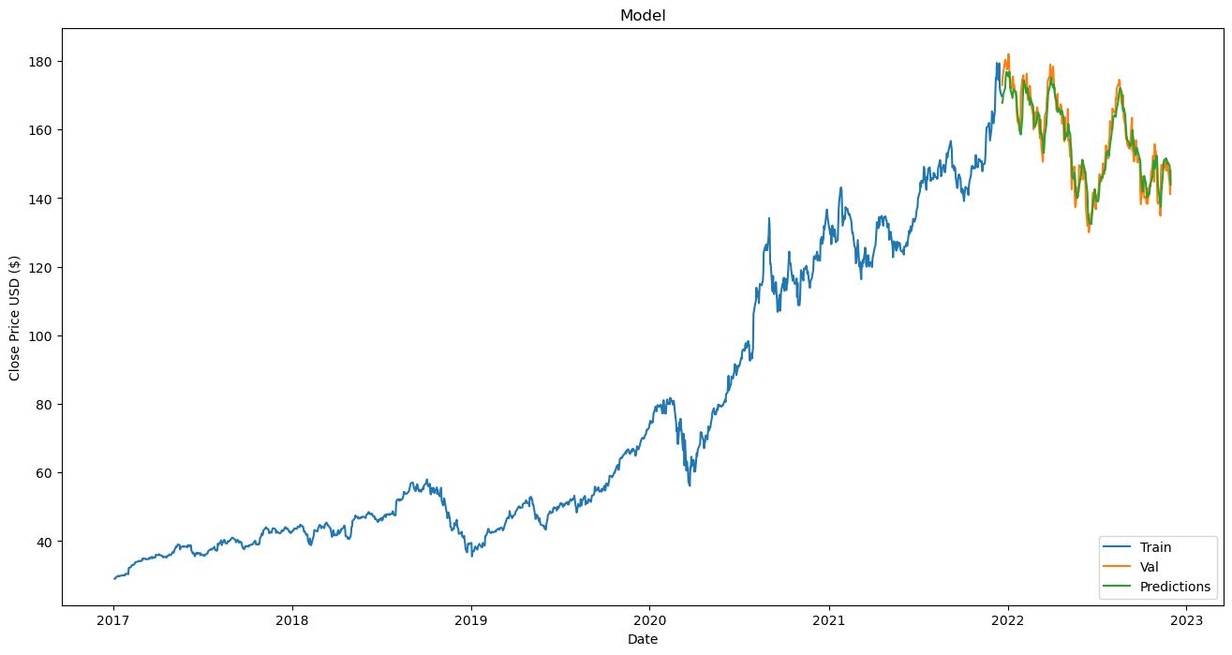
LSTM
Enhancing with Feature Extraction: I extended the model's capabilities by employing feature extraction techniques facilitated by the tsfresh library. Subsequently, I selected the top 10 extracted features and introduced them as inputs to my LSTM model.
Improved Performance: This refinement resulted in a noteworthy improvement in RMSE compared to the intial and windowing method, achieving an RMSE of 3.96.
Summer term 2023
RESEARCH LAB

Slide 13
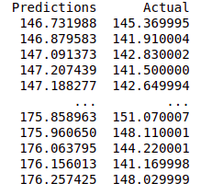
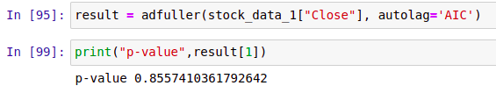
Time Series Forecasting : Apple Stock Data
ARIMA
Modeling with ARIMA: I employed the ARIMA (AutoRegressive Integrated Moving Average) model for forecasting Apple's closing stock prices. This involved using the same training data to make predictions for the test data.
Straight-Line Predictions: Our ARIMA model yielded predicted values that formed a seemingly straight line when plotted. This result was puzzling and indicated that our model was facing some challenges.
Non-Stationary Data: Upon investigation, we discovered a crucial issue—our data was non-stationary, confirmed by the Dickey-Fuller test with a p-value exceeding the significance level of 0.05. Non-stationary data can hinder the performance of time series models like ARIMA.
Summer term 2023
RESEARCH LAB

Slide 14
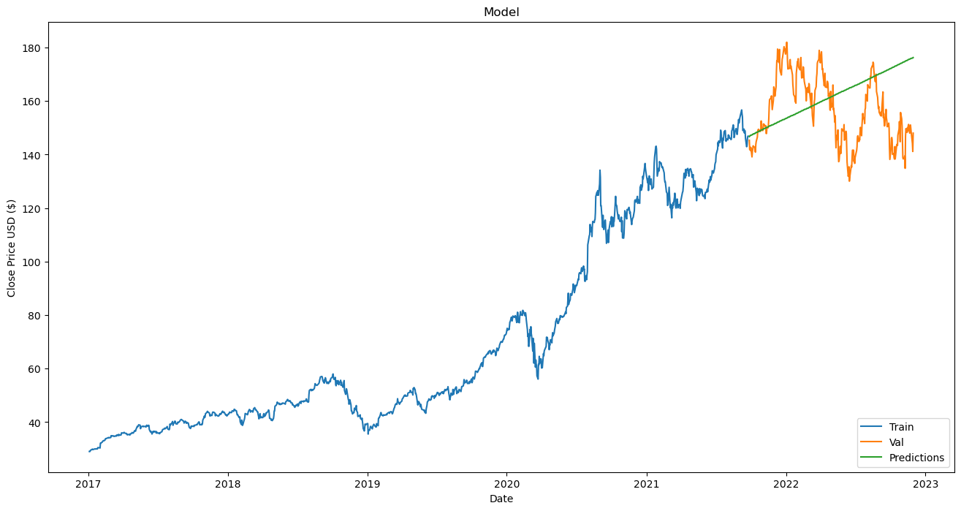
Time Series Forecasting : Apple Stock Data
ARIMA
Summer term 2023
RESEARCH LAB

Slide 15
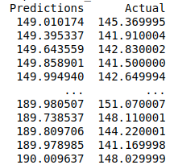
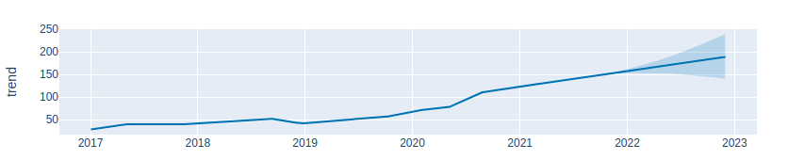
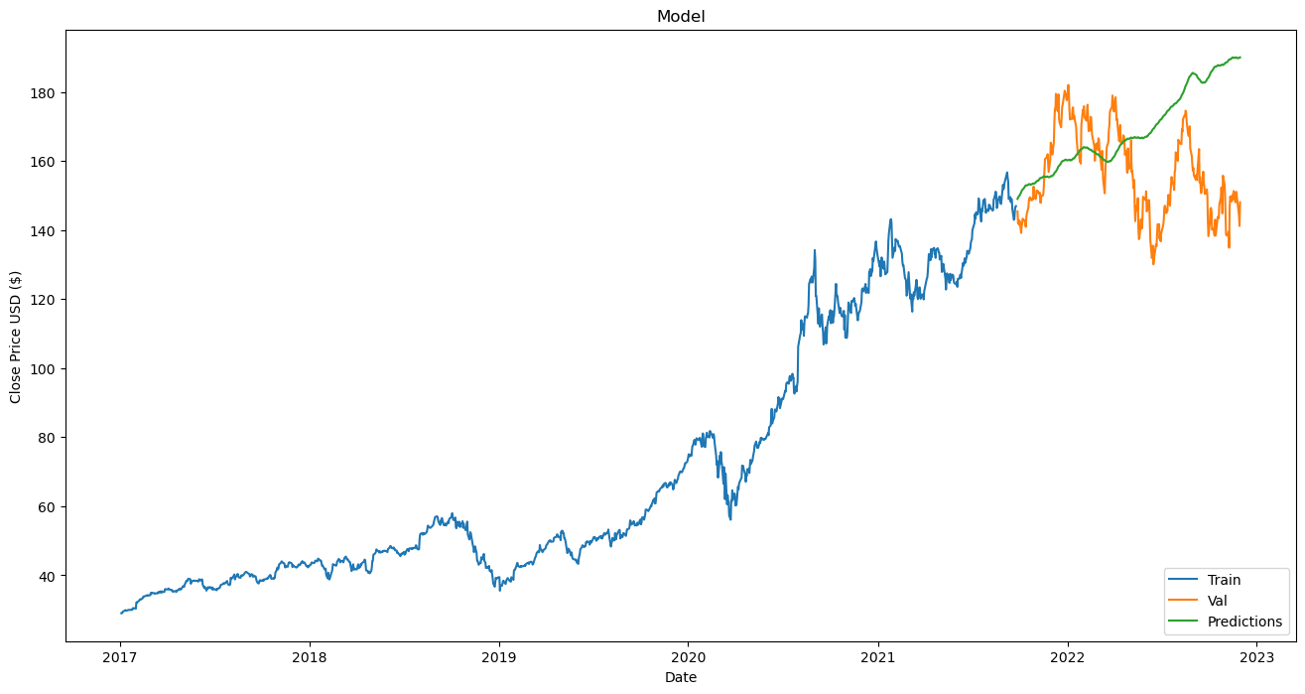
Prophet
Modeling with Prophet: I utilized the same training data with the Prophet model to generate forecasts for the test data.
Model Evaluation: In the evaluation of the Prophet model, we obtained an RMSE (Root Mean Squared Error) value of 23.09.
Summer term 2023
RESEARCH LAB

Slide 16
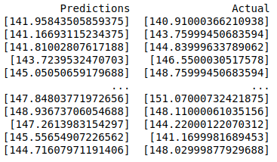
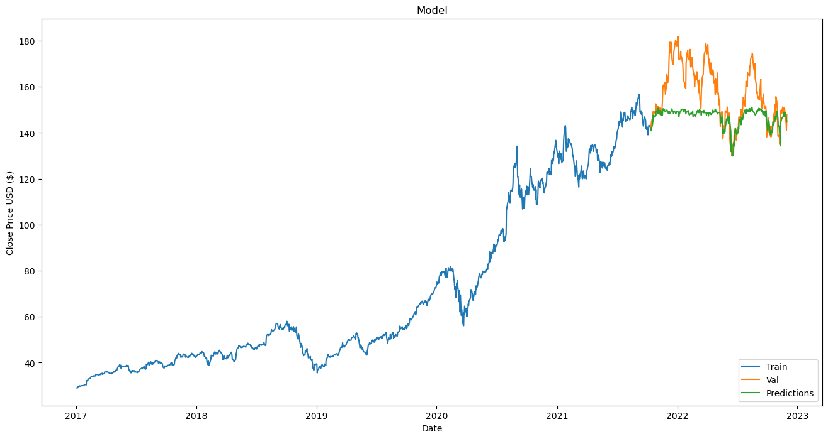
XGBoost
Modeling with Prophet: I utilized the same training data with the XGBoost model to generate forecasts for the test data.
Model Evaluation: In the evaluation of the XGBoost model, we obtained an RMSE (Root Mean Squared Error) value of 14.34.
Summer term 2023
RESEARCH LAB

Slide 17
Comparison & Takeways
Comparison of Apple Stock Price Forecasting Models (RMSE)
LSTM | ARIMA | Prophet | XGBOOST
3.96 | 17.85 | 23.09 | 14.34
Windowing: Dividing the dataset into smaller time window frames allows models like LSTM to capture temporal patterns and able to effectively utilize sequential information for improved time series forecasting.
Feature Extraction: We extract informative features from time series data, including trend, seasonality, and patterns. These features enhance forecasting accuracy by providing valuable insights to the model.
Addressing Non-Stationarity: Non-stationarity, where key statistical properties change over time, can harm model performance. Identifying non-stationarity through tests like Dickey-Fuller allows us to apply essential transformations, enhancing forecasting accuracy.
Summer term 2023
RESEARCH LAB

Slide 18
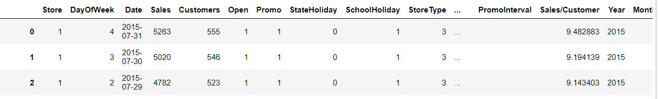
Time Series Forecasting : Rossman Sales Data Dataset
The Rossman sales dataset, contains historical sales data from multiple stores over a period.
The dataset includes thousands of records with various features, such as Store ID, Date, Sales, Customers, Open, Promo, School Holiday, State Holiday, etc.
These features include information about store operations, promotions, other factors affecting the sales.
Data Cleaning and EDA
Handled missing values, performed feature engineering to generate some additional features, data transformation to make it more suitable for modeling.
Visualized before and after data cleaning to check for the impacts.
Performed EDA to identify the seasonality and trends in the data, analyzed and visualized store specific sales pattern, correlational analysis to identify the features highly correlated to sales data.
Summer term 2023
RESEARCH LAB

Slide 19
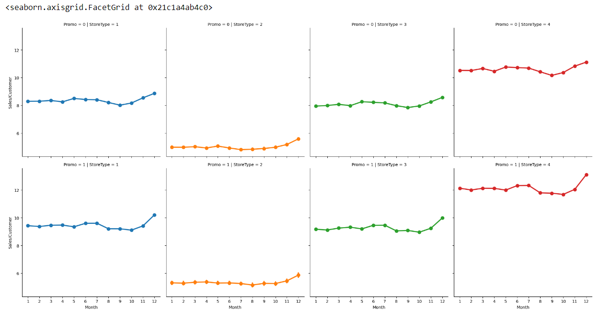
Time Series Forecasting : Rossman Sales Data
Key insights from EDA
The stores are of 4 types as mentioned in the Store Type, a, b, c, d. Each store types has different characteristics and operational attributes according to range of products, store size, neighborhood size, etc.
Out of 4 store types, store 'a' had most sales and customers value, store 'd' had maximum average sales/customers value.
Used heatmap to perform correlational analysis between Sales and other features.
The features that are highly correlated with the Sales are Customers, Promo, Open.
Summer term 2023
RESEARCH LAB

Slide 20
Time Series Forecasting : Rossman Sales Data
SARIMA – Seasonal Auto-regressive Integrated Moving Average
Used Sarima model, as it deals with seasonal patterns and fluctuations.
Checked for the data stationarity using Dickey-Fuller Test.
Identified the seasonal trends and seasonal decomposition in our data.
Sarima requires seasonal (p, d, q, S) and non-seasonal (p, d, q) components to capture the repeating patterns and non-linearity in the data.
p - Auto-regressive order, d – differencing order, q - moving average order
Target Feature – Sales
Initially, we trained the model using random values for the (p, d, q) and it generated RMSE value of 149.23.
We improved our model by using AIC values for the (p, d, q) pair and then by plotting the ACF and PACF plots.
ACF is used to decide the q value, PACF is used to decide the p value (depending upon number of lags)
The final model using ACF and PACF plots, generated RMSE value of 85.28
Summer term 2023
RESEARCH LAB

Slide 21
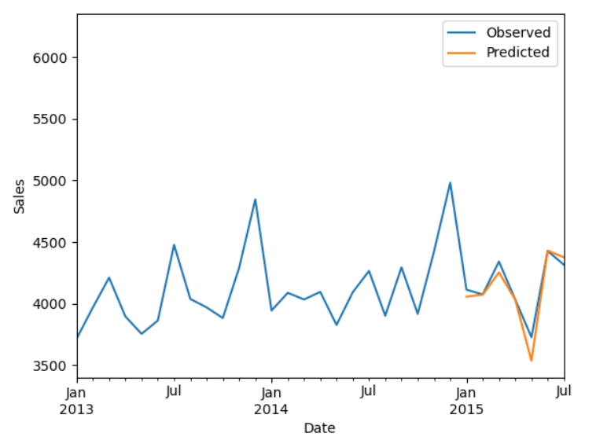
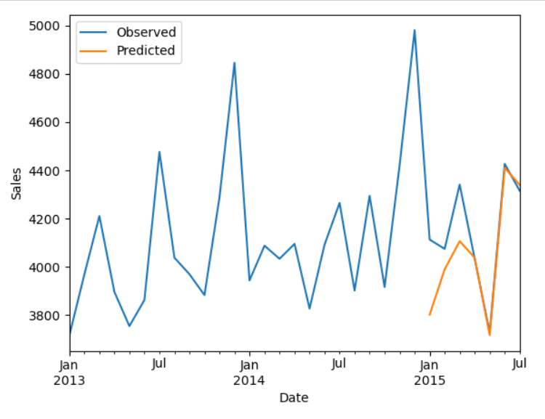
Time Series Forecasting : Rossman Sales Data
SARIMA – Seasonal Auto-regressive Integrated Moving Average
Model with RMSE : 85.28
Model with RMSE : 149.23
Summer term 2023
RESEARCH LAB

Slide 22
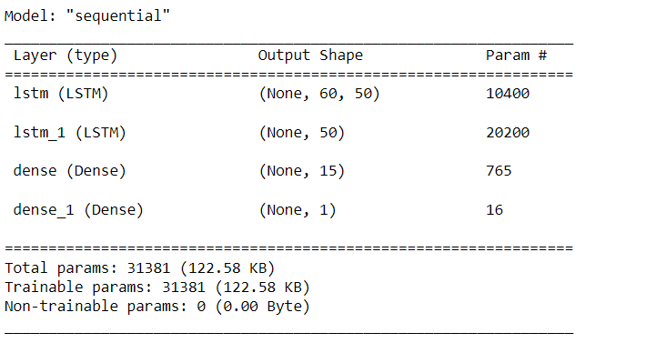
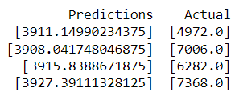
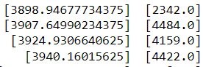
Time Series Forecasting : Rossman Sales Data
LSTM
Normalized the data using min-max scaler to enhance the training of the model and build a basic LSTM model using Keras.
Initially, the model fed on the normalized data gave an RMSE value of more than 500.
We used windowing to feed the data to the model, added additional layers in the model, and increased the epoch value.
After enhancing our model, the model generated RMSE value of 157.7961.
Summer term 2023
RESEARCH LAB

Slide 23
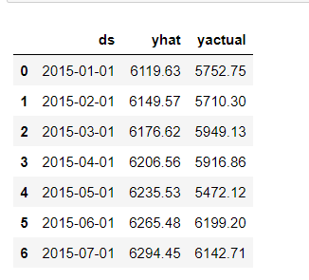
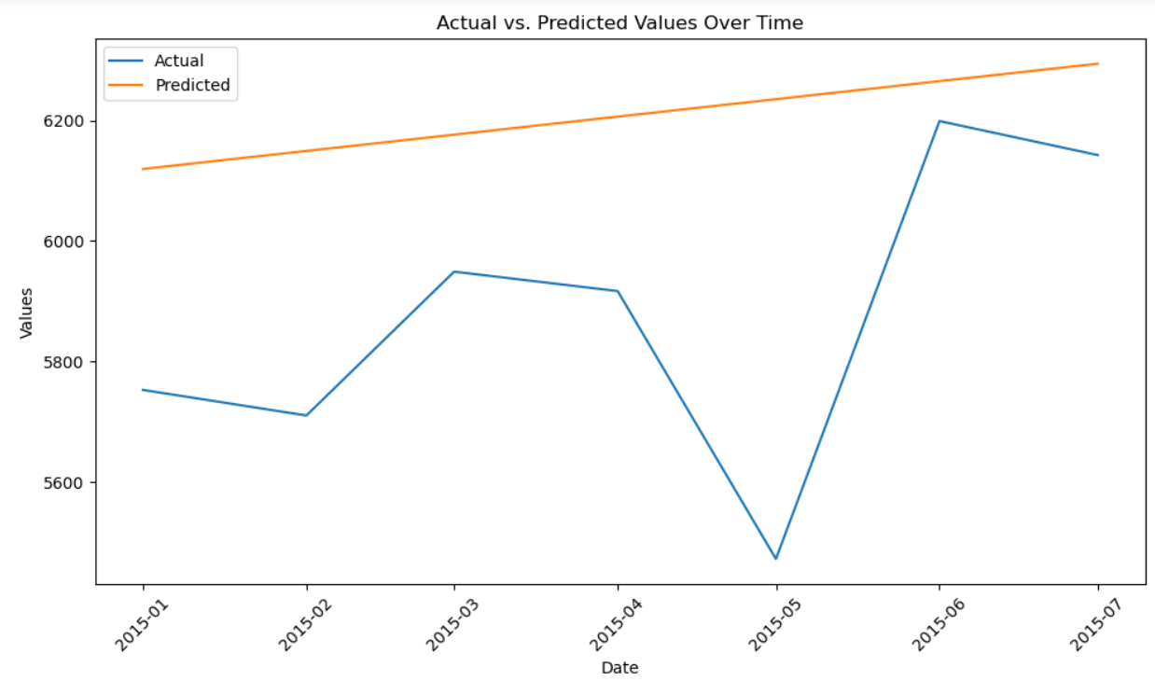
Time Series Forecasting : Rossman Sales Data
Prophet
For the Prophet model, we earlier passed the sales data and forecasted based on the sales data itself.
In this approach, we got higher RMSE values. We added features like Open and Promo that are highly correlated with the Sales to train the model more efficiently.
After doing so, the RMSE values decreased and final RMSE value generated by the Prophet model was 391.601.
Summer term 2023
RESEARCH LAB

Slide 24
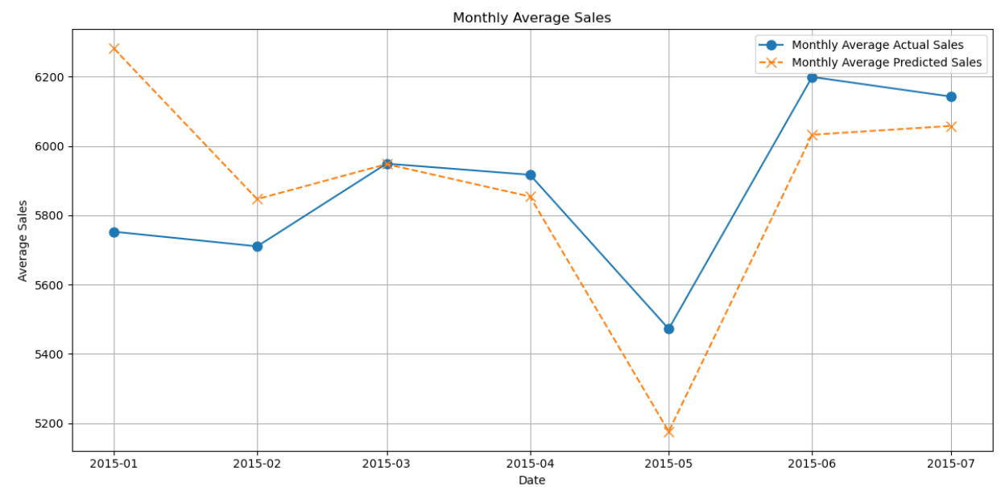
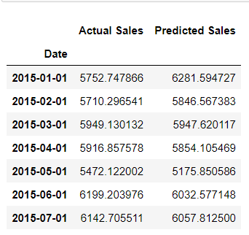
Time Series Forecasting : Rossman Sales Data
XG-BOOST
To work with the XG-boost model, we first dropped all the columns that did not had much impact on the sales data.
Converted categorical values into numerical values of the required columns.
Tuned the parameters required for the model, using default values. This gave an RMSE of 1388.52.
We did hypertuning of the parameters, such as max depth, learning rate and number of iterations to better train the model and avoid it from overfitting.
This enhanced model reduced the RMSE value to 1354.44.
Summer term 2023
RESEARCH LAB

Slide 25
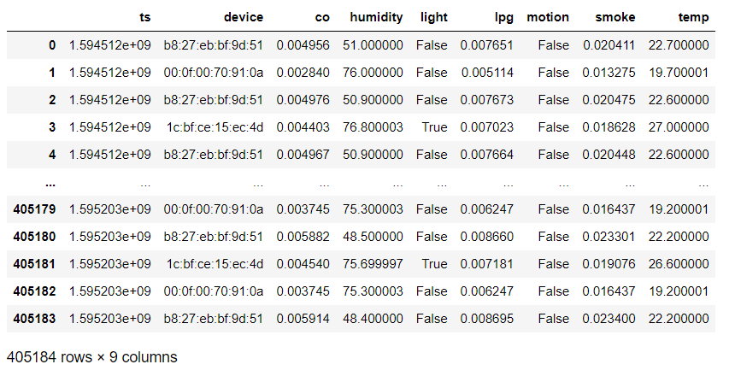
Time Series Forecasting : IoT Sensor Data
DATASET
Summer term 2023
RESEARCH LAB

Slide 26
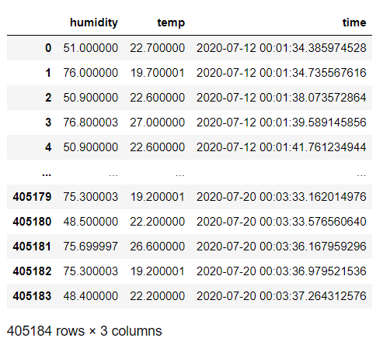
PREPROCESSING STEPS
Data Loading:
Sensor data is loaded from 'sensor.csv' into a Pandas DataFrame.
Column Removal:
The 'motion' column is removed as it contains only false values, making it irrelevant for analysis.
Label Encoding:
Label encoding is applied to two categorical columns, 'device' and 'light', converting them into numerical representations.
Conversion to DateTime:
Ts is converted to DateTime
High Correlation Removal:
Columns 'lpg', 'smoke' and 'co' are dropped due to their high correlation with other features.
Summer term 2023
RESEARCH LAB

Slide 27
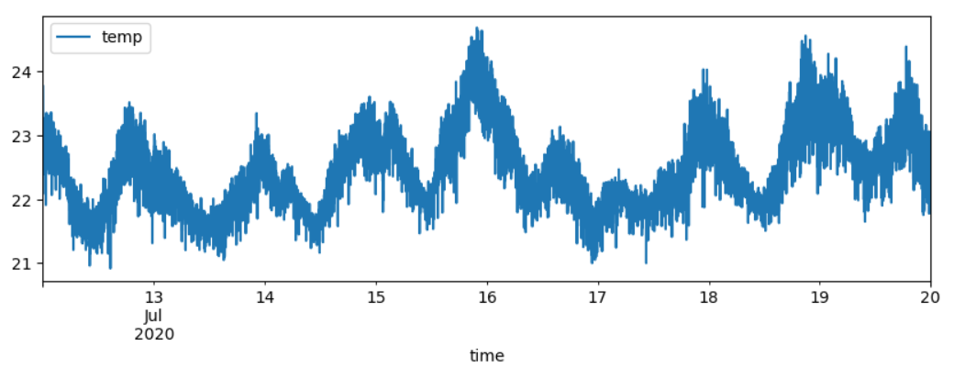
PREPROCESSING STEPS
To enhance data clarity and simplify analysis, the temperature values were resampled at one-minute intervals. This resampling approach provides a more organized and structured representation of the temperature data, enabling better insights and forecasting accuracy.
Summer term 2023
RESEARCH LAB

Slide 28
LIBRARIES USED
Pandas: For data manipulation and analysis.
NumPy: For numerical operations and array manipulation.
Matplotlib: For data visualization.
Prophet: For time series forecasting with flexibility.
Statsmodels: For statistical modeling and ARIMA modeling.
XGBoost: For gradient boosting-based machine learning.
Scikit-Learn: For machine learning utilities, preprocessing, and evaluation.
Hyperopt: For hyperparameter optimization.
TensorFlow: For building and training neural networks.
Tsfresh: For time series feature extraction (used in some algorithms).
Summer term 2023
RESEARCH LAB

Slide 29
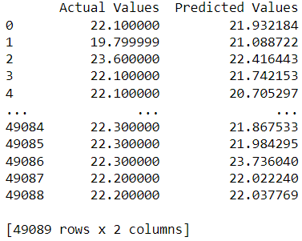
ALGORITHMS (XGBoost)
Algorithm Choice: XGBoost, an efficient gradient boosting library, was selected for temperature forecasting due to its ability to handle time series data effectively.
Data Preparation: The data was prepared for time series prediction by creating input sequences and corresponding target values. A rolling window approach was applied to split the data into training and testing sets.
Hyperparameter Tuning: Hyperopt was employed to optimize XGBoost hyperparameters, including the number of estimators, maximum depth, learning rate and feature column sampling. This process enhances the model's predictive accuracy.
Model Training: The XGBoost model was trained using the best hyperparameters obtained from the optimization process.
Summer term 2023
RESEARCH LAB

Slide 30
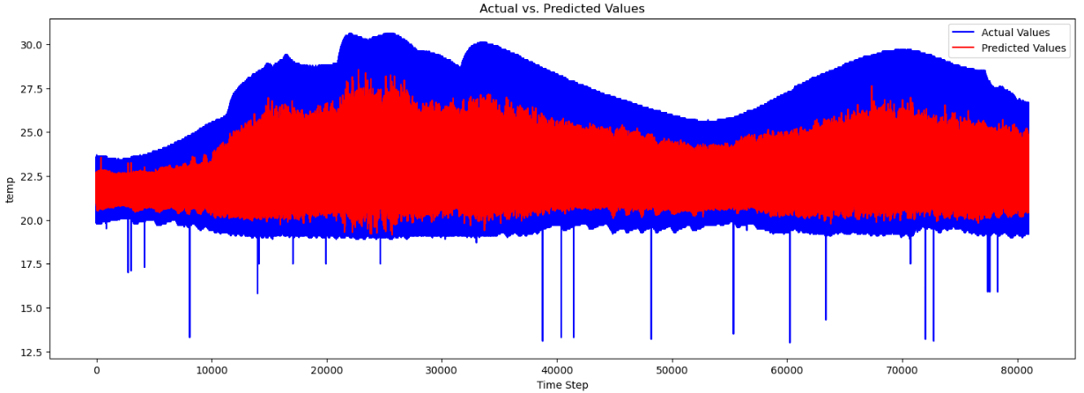
ALGORITHMS (XGBoost)
Outlier Removal: Outliers were removed using Z-score-based filtering to improve the model's robustness.
Performance Evaluation: The model's performance was assessed using Root Mean Square Error (RMSE) on the test data without outliers.
Visualization: Actual vs. predicted temperature values were visualized to showcase the model's forecasting capabilities.
Summer term 2023
RESEARCH LAB

Slide 31
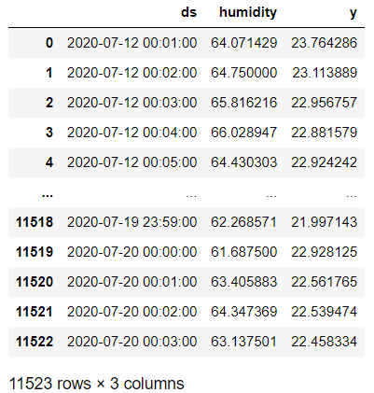
PROPHET
Algorithm Choice: The Prophet algorithm was employed for temperature forecasting. Prophet is well-suited for time series data and offers forecasting capabilities with inherent support for holidays and special events.
Data Preprocessing: The sensor data was preprocessed by removing columns like 'motion' and correlated features ('lpg,' 'smoke,' 'co,' 'light'). The 'time' column was converted to a datetime format for time-based analysis.
Renaming Columns: To adhere to Prophet's required column naming conventions, the dataset columns were renamed. 'time' was renamed to 'ds,' 'temp' to 'y,' 'humidity' to 'humidity'.
Resampling: To improve data visualization and analysis, the temperature data was resampled at one-minute intervals ('T') and plotted to provide a clearer representation of temperature trends over time.
Summer term 2023
RESEARCH LAB

Slide 32
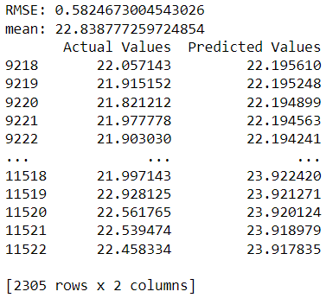
PROPHET
Train-Test Split: The dataset was split into training and testing sets, with training data used to build the Prophet model and testing data for evaluation.
Model Fitting: The Prophet model was initialized, fitted to the training data, and used to make future temperature predictions.
Evaluation: The Root Mean Square Error (RMSE) was calculated to assess the model's predictive accuracy, and the model's performance was compared to the mean temperature value in the test data.
Visualization: The predicted and actual temperature values were visualized over time, showcasing the model's ability to capture temperature trends.
Summer term 2023
RESEARCH LAB

Slide 33
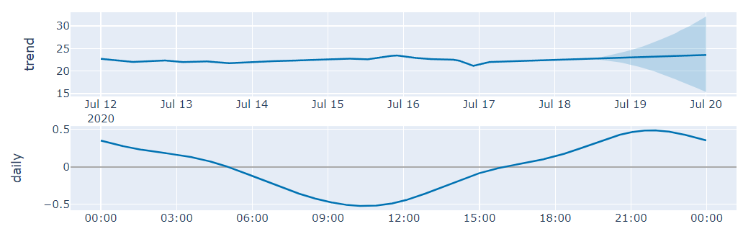
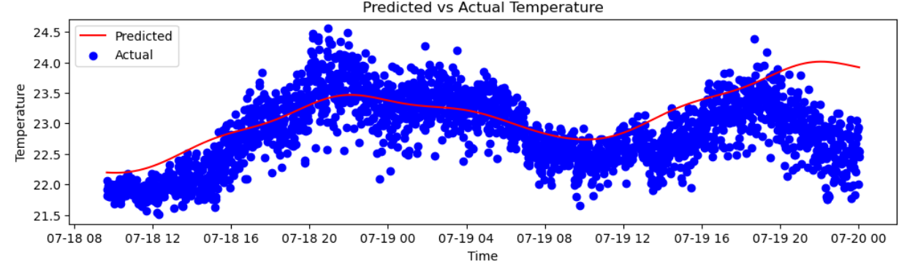
PROPHET
Summer term 2023
RESEARCH LAB

Slide 34
Long Short Term Memory (LSTM)
Algorithm Choice: Long Short-Term Memory (LSTM) neural network was utilized for temperature forecasting. LSTM networks excel in capturing sequential patterns, making them ideal for time series forecasting tasks.
Data Preprocessing: Sensor data was downloaded and preprocessed by removing the 'motion' column and applying label encoding to 'device' and 'light.' Highly correlated columns ('lpg,' 'smoke,' 'co,' 'ts') were also dropped.
Data Preparation: The data was prepared for time series prediction by creating input sequences and corresponding target values. A rolling window approach was employed for dataset splitting.
Model Training: The LSTM model was trained on the prepared data with a specified number of epochs and batch size.
Outlier Removal: Outliers were filtered out based on Z-scores to enhance the model's robustness.
Evaluation: The Root Mean Square Error (RMSE) was calculated to assess the model's forecasting accuracy.
Summer term 2023
RESEARCH LAB

Slide 35
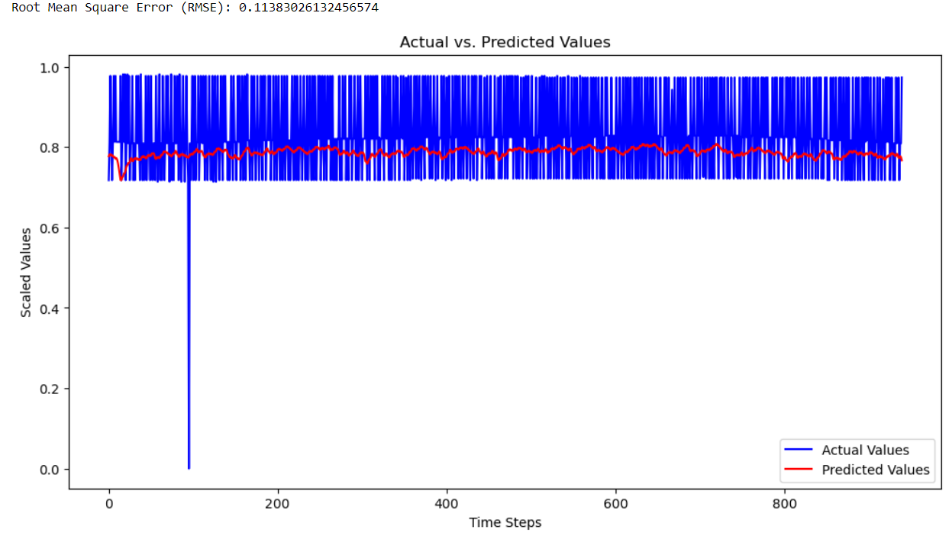
Long Short Term Memory (LSTM)
Visualization: Actual vs. predicted temperature values were visualized over time, demonstrating the model's ability to capture temperature trends and patterns.
Summer term 2023
RESEARCH LAB

Slide 36
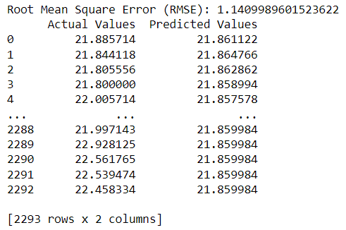
Auto Regressive Integrated Moving Average (ARIMA)
Algorithm Choice: The AutoRegressive Integrated Moving Average (ARIMA) model was employed for temperature forecasting. ARIMA is a time series forecasting method that models the relationship between a series of observations with its own lagged values and past forecast errors.
Data Preprocessing: Sensor data was downloaded and preprocessed by removing the 'motion' column and applying label encoding to 'device' and 'light.' Highly correlated columns ('lpg,' 'smoke,' 'co,' 'ts') were also dropped.
Data Preparation: The data was prepared for time series prediction by creating input sequences, including both temperature and humidity values. A rolling window approach was employed for dataset splitting.
Model Fitting: The ARIMA model was fitted to the training data using the ARIMA library.
Summer term 2023
RESEARCH LAB

Slide 37
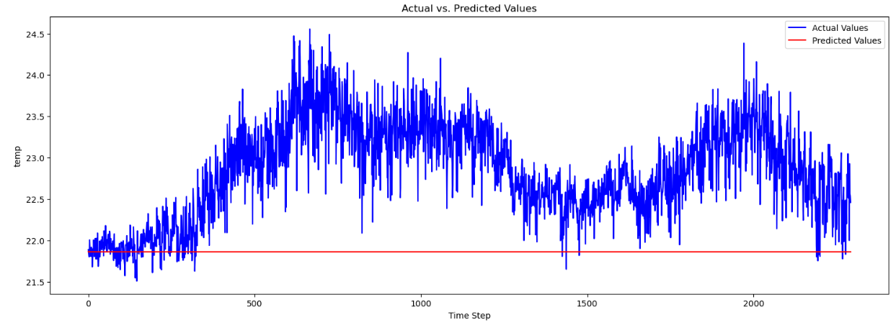
Auto Regressive Integrated Moving Average (ARIMA)
Prediction: Temperature predictions were made using the fitted ARIMA model to forecast values for the test data.
Outlier Removal: Outliers were filtered out based on Z-scores to enhance the model's robustness.
Evaluation: The Root Mean Square Error (RMSE) was calculated to assess the model's forecasting accuracy.
Visualization: Actual vs. predicted temperature values were visualized over time, illustrating the model's ability to capture temperature trends and patterns.
Summer term 2023
RESEARCH LAB

Slide 38
KEY TAKEAWAYS
LSTM (Long Short-Term Memory): Outperformed other algorithms with an impressively low RMSE of 0.1138, showcasing its ability to capture temporal dependencies in sensor readings.
Rolling Window: Window size is a crucial parameter when splitting data through rolling window approach. (in my case each row represents a minute of data, So a window size of 60 would correspond to a one-hour window, which might be appropriate for capturing hourly patterns.
Hyperopt Tuning: Hyperoptimization is a valuable tool for optimizing the hyperparameters of machine learning models. It automates the search for the best hyperparameter settings, improving model performance without manual trial and error.
Summer term 2023
RESEARCH LAB

Slide 39
Time Series Forecasting : Walmart Sales Data
DATASET
We utilized Walmart sales data from February 2, 2010, to February 24, 2012.
It contains historical sales data from different stores.
The feature datasets include different features such as isHoliday, Temperature, Fule_Price, CPI, etc.
Summer term 2023
RESEARCH LAB

Slide 40
Time Series Forecasting : Walmart Sales Data
Preprocessing
Data Integration: Merged features from multiple data frames to create a single data frame
Data Cleaning: we handled NaN Values and removed some duplicate and irrelevant columns.
DateTime Conversion: converted Date to DateTime.
Encoding: we applied custom encoding on the categorial column 'IsHoliday' and converted it to the numerical column.
Summer term 2023
RESEARCH LAB

Slide 41
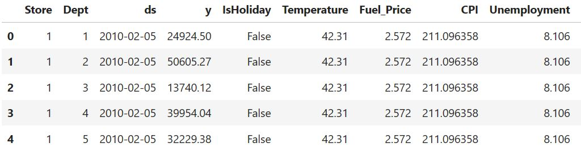
Time Series Forecasting : Walmart Sales Data
Prophet Algorithm
Prophet is Facebook's Core Data Science team and a popular choice for time series forecasting
In preprocessing, we removed some feature columns, and the date was converted to DateTime.
We renamed the columns 'Date' and 'Sale' to 'ds' and 'y' as per the recommendation of the prophet.
Summer term 2023
RESEARCH LAB

Slide 42
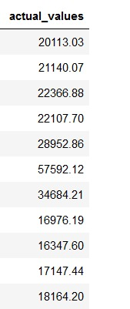
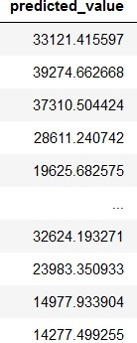
Time Series Forecasting : Walmart Sales Data
Prophet Algorithm
The dataset was split into training and testing data sets
Fitted training data to the model by initializing the prophet model and forecast the future sales data
Calculated RMSE value to check the forecasting accuracy of the model.
Summer term 2023
RESEARCH LAB

Slide 43
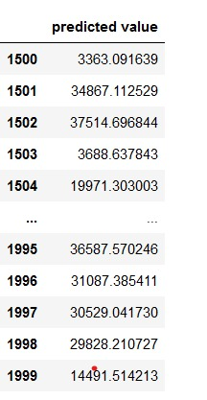
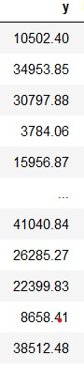
Time Series Forecasting : Walmart Sales Data
Seasonal Autoregressive Integrated Moving Average(SARIMA)
SARIMA is particularly useful in scenarios where your time series data has seasonality
In preprocessing, we have removed some features
The dataset was split into training and testing data sets
We used seasonal(p, d, q, s) and non-seasonal(p, d, q) for capturing repeating patterns
Fitted training data to the model by initializing the SARIMA model and forecasted the future sales data.
Summer term 2023
RESEARCH LAB

Slide 44
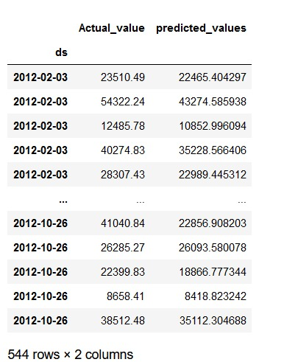
Time Series Forecasting : Walmart Sales Data
XGBoost
The dataset was split into training and testing data sets based on the date
Fitted training data to the model by initializing the XGBoost model and forecasted the future sales data.
Summer term 2023
RESEARCH LAB

Slide 45
Time Series Forecasting : Google Stock Data
Literature Review
Research Papers
Time-series forecasting of seasonal items sales using machine learning
Forecasting at Scale
A Variational Bayesian Deep Network with Data Self-Screening Layer for Massive Time-Series Data Forecasting
Key Findings
Helped in getting an overall idea about which algorithms have better performance on a data set
Prophet showed good results in understanding the seasonality pattern
Summer term 2023
RESEARCH LAB

Slide 46
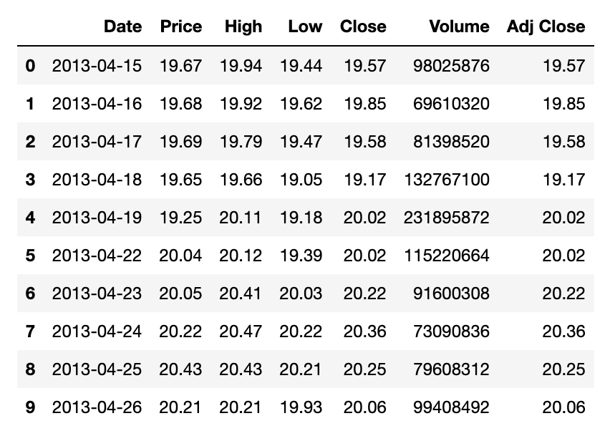
Time Series Forecasting : Google Stock Data
About the Dataset
The data set had daily google stock price information from April 2013 to March 2023
Contained 2510 data points with 7 columns
Target Variable : Adj Close
Summer term 2023
RESEARCH LAB

Slide 47
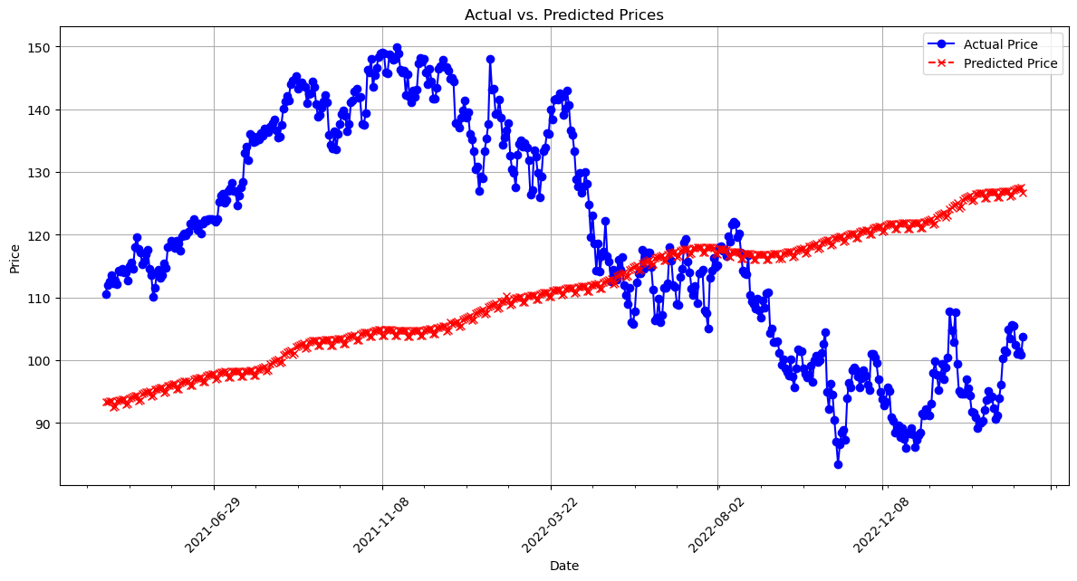
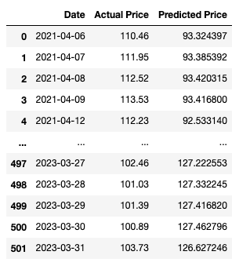
Time Series Forecasting : Google Stock Data
Prophet
Was the easiest to use for forecasting
The RMSE value came to 27.148
Summer term 2023
RESEARCH LAB

Slide 48
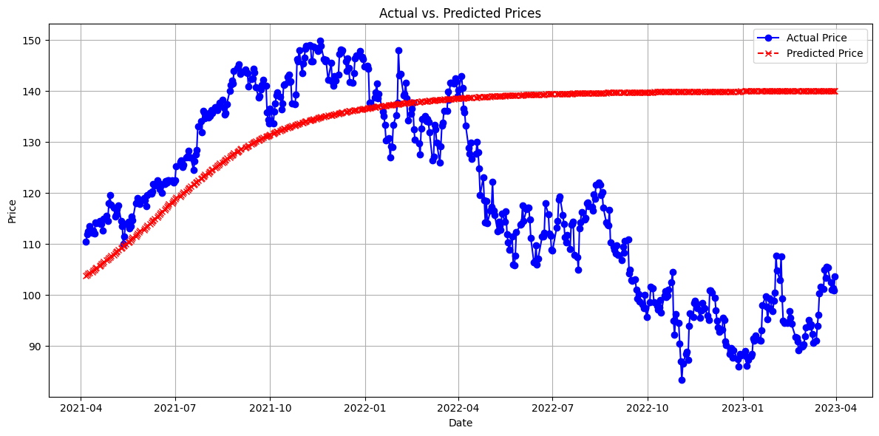
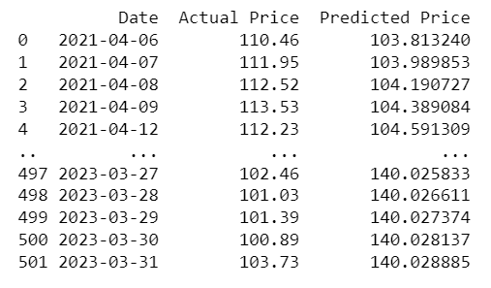
Time Series Forecasting : Google Stock Data
LSTM
Was not able to capture the underlying patterns as effectively as XGBoost.
The RMSE value came to 26.740
Summer term 2023
RESEARCH LAB

Slide 49
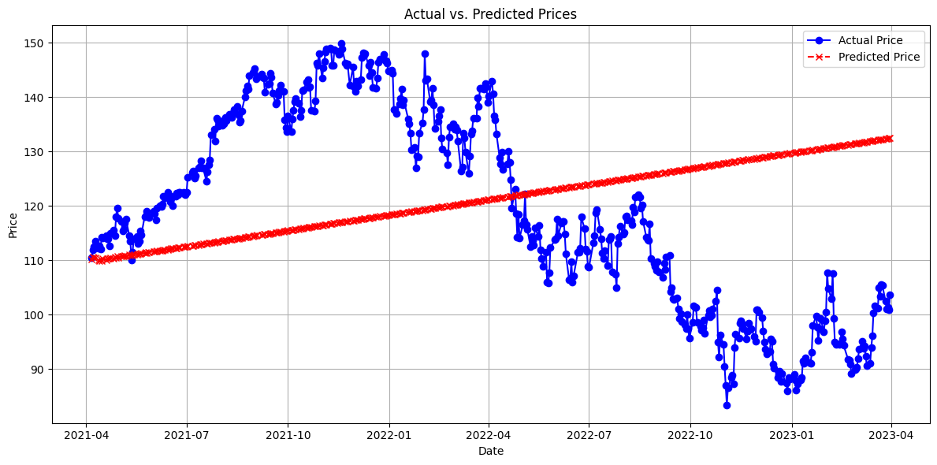
Time Series Forecasting : Google Stock Data
ARIMA
ARIMA/SARIMA may work well for datasets with clear linear or seasonal patterns but struggles with more complex relationships.
The RMSE value came to 23.442
Summer term 2023
RESEARCH LAB

Slide 50


Time Series Forecasting : Google Stock Data
XGBoost
It outperforms all other algorithms in terms of prediction accuracy, having the lowest MSE.
The RMSE value came to 22.417
Summer term 2023
RESEARCH LAB

Slide 51

Time Series Forecasting : Google Stock Data
Optimization
Parallel Optimization: used SparkTrials to run hyperparameter optimization tasks in parallel across multiple Spark nodes in Databricks.
The fmin() function benefits from Spark's distributed computing capabilities.
Passing the new parameters to the XGBoost model resulted in bringing down the RMSE by 8%
Summer term 2023
RESEARCH LAB

Slide 52
Time Series Forecasting : Google Stock Data
Key Takeaways
XGBoost Outperforms: XGBoost has the lowest MSE value (22.417), indicating that it performs the best among the four algorithms in terms of prediction accuracy. Lower MSE values indicate better predictive performance.
ARIMA: ARIMA, while having a lower MSE compared to LSTM and Prophet, still has a higher MSE (23.442) compared to XGBoost, suggesting that XGBoost provides better predictions for this dataset.
Summer term 2023
RESEARCH LAB

Slide 53
Collective Insights
Now that each team member has presented their work, let's draw some common conclusions.
 | ARIMA/SARIMA | LSTM | PROPHET | XGBoost
Apple Stock Data | 3.96 | 17.85 | 23.09 | 14.34
Google Stock Data | 23.442 | 26.740 | 27.148 | 22.417
IoT Sensor Data | 1.140 | 0.1138 | 0.582 | 2.859
Rossman Sales Data | 85.28 | 157.79 | 391.601 | 1354..44
Wallmart Sales Data | 6897.78 | NA | 1087.55 | 7005.51
*The above table indicates the RMSE values for the data sets on the
Summer term 2023
RESEARCH LAB

Slide 54
Key Takeaways
LSTM/XGBoost excelled in forecasting stock data, providing precise forecasts.
SARIMA emerged as the top performer for sales data, capturing seasonality and trends effectively.
For IoT sensor data, LSTM once again demonstrated its prowess, delivering accurate forecasts for complex and time-varying patterns.
Code and Documentation can be found on our GitHub repository
https://github.com/chandeldhruvsingh/time-series-forecasting-research
Summer term 2023
RESEARCH LAB

Slide 55
Future Work
Ensemble Methods: One promising direction is the exploration of ensemble methods. Combining the strengths of multiple forecasting algorithms can lead to enhanced predictive accuracy and robustness, especially in complex, noisy datasets.
Interpretability: Incorporating interpretability into forecasting models is crucial for gaining insights into model decisions. Research in this area can bridge the gap between model predictions and actionable insights.
Summer term 2023
RESEARCH LAB

Slide 56
Refrences
Williams, R. J. and Zipser, R. A., A learning algorithm for continually training neural networks. Neural computation, vol. 1, 1989, pp. 270–280.
Yasaman Ensafi, Saman Hassanzadeh Amin, Guoqing Zhang, Bharat Shah, Time-series forecasting of seasonal items sales using machine learning – A comparative analysis, https://doi.org/10.1016/j.jjimei.2022.100058.
R. Adhikari and R. K. Agrawal, “An Introductory Study on Time Series Modeling andForecasting”,MTech.thesis, Jawaharlal Nehru University, New Delhi, India, 2013. https://www.researchgate.net/publication/235219651_An_Introductory_Study_on_Time_series_Modeling_and_Forecasting
Summer term 2023
RESEARCH LAB

Slide 57
Thanks for your Attention! Your questions ...

